Slide 1
Medical approach to adenomyosis
Dr S.Foroughinia

Slide 3
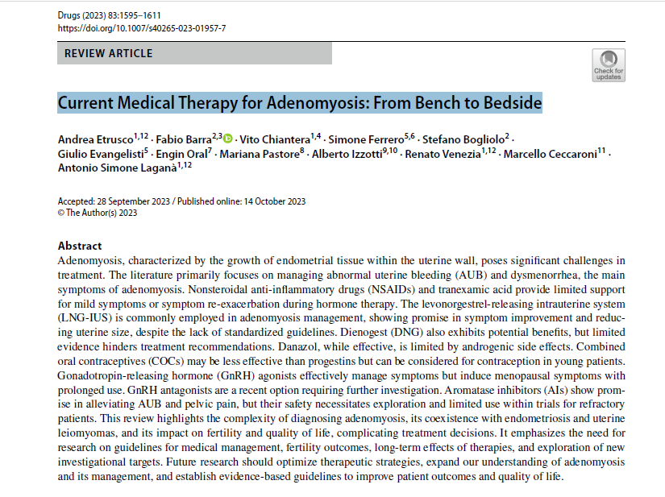

Slide 4
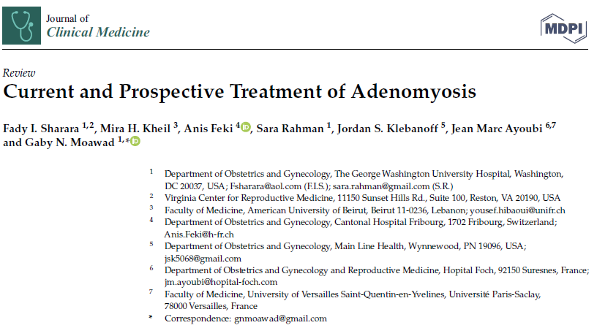

Slide 5
Affecting women at various ages with different symptoms.
No longer considered typical of women over 40 years of age
Around 30% of young women are affected by adenomyosis .
Adenomyosis is diagnosed in 22% of infertile women less than 40 years old undergoing ART.
Thus, a conservative management aiming to preserve or restore fertility and manage clinical symptoms should be considered.( may necessitate long-term medical therapy that extends until menopause )

Slide 6
No drug is currently labelled for adenomyosis.
Medical treatments effective in improving symptoms (pain, abnormal uterine bleeding and infertility).
The rationale : pathogenetic mechanisms : sex steroid hormones aberrations, impaired apoptosis, and increased inflammation.
Several nonhormonal (i.e., nonsteroidal anti-inflammatory drugs) and hormonal treatments (i.e., progestins, oral contraceptives, gonadotropin-releasing hormone analogues) .

Slide 7
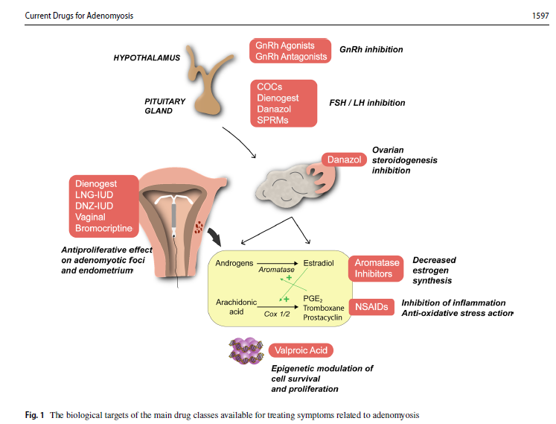

Slide 8
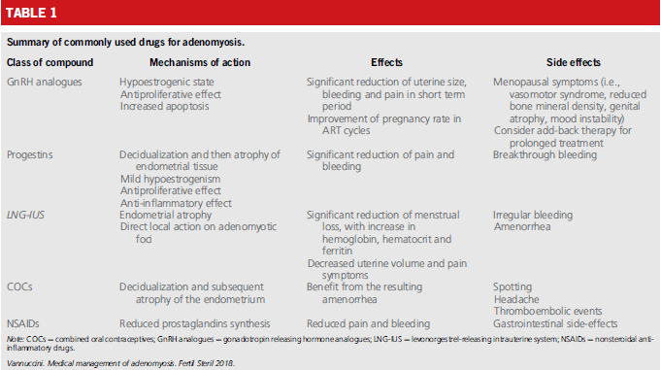

Slide 9
NON-STEROIDAL ANTI-INFLAMMATORY DRUGS
Mechanisms of action: Reduced prostaglandins synthesis(blocking enzyme COX)
Effects: anti-inflammatory and pain-relieving, used in symptomatic therapy(AUB, Pain)
May exert a hemostatic effect by reducing profuse bleeding.
Side effects: Gastrointestinal side-effects
Systematic review :effective in menstrual pain, not indicating which drug is the most appropriate and the safest.
Another systematic review : reducing menstrual bleeding, even though they are less effective than hormonal treatment or tranexamic acid .

Slide 10
PROGESTINS
Decreased expression of progesterone receptors (PR) A and B in adenomyotic tissue, similar to endometriosis, Progesterone induces antiproliferative activity.
Mechanisms of action:
Decidualization and then atrophy of endometrial tissue
Mild hypoestrogenism
Antiproliferative effect
Anti-inflammatory effect
Effects:
Significant reduction of pain and bleeding
Side effects: Breakthrough bleeding

Slide 11
Norethindrone Acetate
Inhibit estradiol-induced vascular endothelial growth factor & stromal cell-derived factor 1 in human endometrial stromal cells reducing bleeding and pain.
Act on the progesterone resistance observed in ectopic and eutopic endometrium.
Moderate or severe pelvic pain and bleeding: obtaining a significant improvement of both dysmenorrhea and bleeding after treatment (5 mg/d dose) .
The ‘three weeks on, one week off’ regimen : to minimize the common side effect of breakthrough bleeding, causing an incomplete suppression of the hypothalamic-pituitaryovarian axis and a less hypoestrogenic effect.
NETA : effective, well tolerated and inexpensive medical treatment for adenomyosis, with few and mild side effects
Muneyyirci-Delale O, Chandrareddy A, Mankame S, Osei-Tutu N, von Gizycki H. Norethindrone acetate in the medical management of adenomyosis. Pharmaceuticals 2012;5:1120–7.

Slide 12
Dienogest
a fourth-generation progestin derived from 19-nortestosterone that binds to PR with high affinity.
taken continuously, DNG inhibits systemic gonadotropin secretion and has additional antiproliferative and local anti-inflammatory effects on endometrial tissue .
Mild inhibition of ovarian function, slight hypoestrogenic effects, and it exerts an antiproliferative action on the endometrium.
Cellular proliferation of adenomyotic cells is inhibited by inducing apoptotic pathways.
Significant changes in the immune system, with an increased number of uterine infiltrating NK cells in glandular structure of eutopic endometrium, a potential beneficial effect on embryo implantation, (NK cells supports the preparation of uterus for embryo implantation by producing many cytokines.)
Effective in reducing pain score scale for dysmenorrhea and pelvic pain.

Slide 13
First pilot study: on DNG: seventeen premenopausal women,symptomatic adenomyosis , resulted effective in improving pain, some more frequent menorrhagia ,worsening of anemia
Another study : long-term administration of DNG (52 weeks) :effective in reducing dysmenorrhea. improving patients' quality of life. common adverse reactions included metrorrhagia (96.9%) and hot flush (7.7%), bleeding, (progestational action of DNG on the endometrium), was tolerable.
Studies the long-term treatment ; well tolerated, even up to menopause, an alternative to avoid hysterectomy
Neriishi K, Hirata T, Fukuda S, Izumi G, Nakazawa A, Yamamoto N, et al. Long-term dienogest administration in patients with symptomatic adenomyosis. J Obstet Gynaecol Res. 2018;44(8):1439–44.
Osuga Y, Watanabe M, Hagino A. Long-term use of dienogest in the treatment of painful symptoms in adenomyosis. J Obstet Gynaecol Res. 2017;43(9):1441–8.

Slide 15
LNG-IUS and DNG comparably reduced pain in adenomyosis.
The days of bleeding after 12 months with DNG were significantly decreased compared to those with LNG-IUS.
Conclusions: LNG-IUS and DNG could be useful for long-term management of adenomyosis. In terms of durations of uterine bleeding, DNG was superior to LNG-IUS for 6 years

Slide 17
Pain: significantly decreased in both groups
Decreased rate was more pronounced in the dienogest group (3.21 ± 1.18) in comparison with the COCs group (4.92 ± 1.22).
Bleeding pattern was improved greatly; uterine volume decreased significantly in the dienogest group.
Conclusion:
Dienogest and COCs are effective in treating adenomyosis-associated symptoms after 6 months of use but dienogest is more effective. The decrease in uterine volume and uterine artery blood flow may be the cause of the treatment effect.
Hassanin, A.I., Youssef, A.A., Yousef, A.M. and Ali, M.K., 2021. Comparison of dienogest versus combined oral contraceptive pills in the treatment of women with adenomyosis: A randomized clinical trial. International Journal of Gynecology & Obstetrics, 154(2), pp.263-269.

Slide 19
The comparison DNG and GnRH analogues showed no difference in terms of pelvic pain reduction, as both were effective in pain control. However, four months of treatment with GnRH analogues induced a greater reduction of AUB symptoms and uterine volume evaluated by ultrasound
Dienogest effectively alleviates the symptoms of dysmenorrhea, but GnRH-a is more effective in improving anemia and reducing the uterine volume in patients with adenomyosis.
Miaomiao Ji, Ming Yuan, Xue Jiao, Qiuju Li, Yufei Huang, Jing Li & Guoyun Wang (2022) A cohort study of the efficacy of the dienogest and the gonadotropin-releasing hormone agonist in women with adenomyosis and dysmenorrhea, Gynecological Endocrinology, 38:2, 164-169.

Slide 20
Levonorgestrel-releasing Intrauterine System
Highly effective and safe contraceptive, for up to 5 years.
Reducing systemic exposure, concentration of LNG in uterine cavity:1000 times higher than bloodstream.
Mechanisms of action: direct effect on adenomyotic foci, also modulatory action on endometrial factors.
Local action: down-regulating estrogen receptors, induces decidualization and atrophy of the ectopic endometrium.
Effects: Significant reduction of menstrual loss, with increase in hemoglobin, hematocrit and ferritin. Decreased uterine volume and pain symptoms
Side effects: minimal local & systemic, Irregular bleeding,Amenorrhea
Once inserted, long-lasting effect, cost-effective. especially mild and moderately severe adenomyosis, reducing the need for surgical interventions.

Slide 21
RCT: promising alternative therapy to hysterectomy, comparable improvements in hemoglobin , superior effects on psychological well-being.
RCT: (COCs) vs LNG-IUS both reduced pain and menstrual loss, but the intrauterine device is more effective.

Slide 23
Ten prospective studies (patients n=551) were included.
LNG-IUS led to significant reductions in pain score after 12months Similarly, the Pictorial Blood Assessment Chart (PBAC) showed significant reduction up to 36 months after LNG-IUS insertion .
The LNG-IUS led to significant reductions in the uterine volume .
Conclusions: LNG-IUS is a promising and effective option for the management of adenomyosis. Its use effectively reduced the severity of symptoms, uterine volume and endometrial thickness, and improved laboratory outcomes.
.

Slide 24
Limitations:
It is recommended that all IUDs be inserted in uteri at a depth below 9 cm
Nelson AL. Contraindications to IUD and IUS use. Contraception. 2007 Jun;75(6 Suppl):S76-81. doi: 10.1016/j.contraception.2007.01.004. Epub 2007 Mar 2. PMID: 17531621.
As Park et al. reported, 37.5% of patients with large symptomatic adenomyosis experienced LNGIUS expulsion, and almost all of which occurred during the frst 6 months
Cutoff value of uterine volume more than 150 mL(>12wks) significantly associated with failure of LNG-IUS: LNG-IUS in a large volume uterus has a significantly higher failure rate than small ones
Lee KH, Kim JK, Lee MA, Ko YB, Yang JB, Kang BH,et al. Relationship between uterine volume and discontinuation of treatment with levonorgestrel-releasing intrauterine devices in patients with adenomyosis. Arch Gynecol Obste. 2016;294(3):561–6.

Slide 25
combined treatment with GnRH-as and LNGIUS was effective in reducing both symptoms and uterus size in patients with adenomyosis and an enlarged uterus.
21 adenomyosis patients ,uterine volumes >12 weeks , GnRHa at interval of 28 days for a total of 3-4 cycles when uterine length <10 cm by ultrasound, LNG-IUS was expelled in 3 patients( expulsion rate of 14%). Side effects were few
Zhang P, Song K, Li L, Yukuwa K, Kong B. Efficacy of combined levonorgestrel-releasing intrauterine system with gonadotropin- releasing hormone analog for the treatment of adenomyosis. Med Princ Pract. 2013;22(5):480–3.
12 patients with adenomyosis , suture fxation with an LNG-IUS, depth of their uterine cavity was greater than 9 cm, with an average of 9.79 cm ,complete remission of their symptoms Only one person reported expulsion a year). performed suture fxation of the LNG-IUS in the uterine cavity by using the hysteroscopic cold knife surgery system (HCSS), and satisfactory results were obtained Notably, the incidence of expulsion of the LNG-IUS during our follow-up observation period was extremely low (1/12)

Slide 27
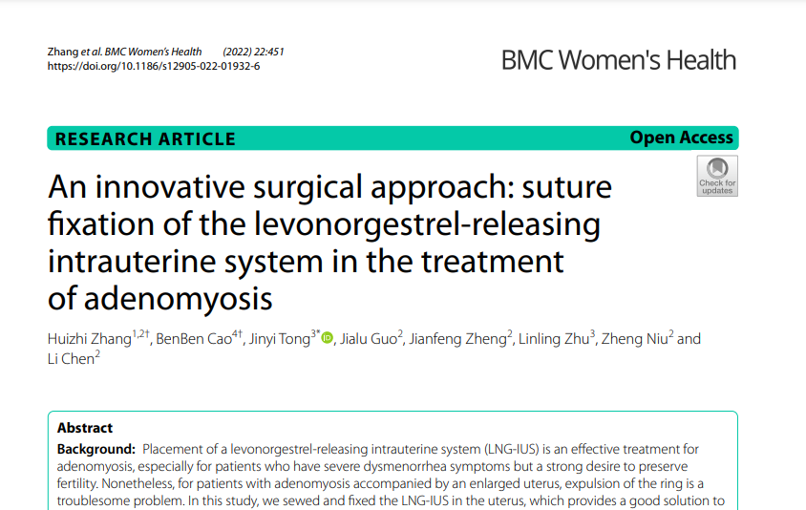

Slide 28
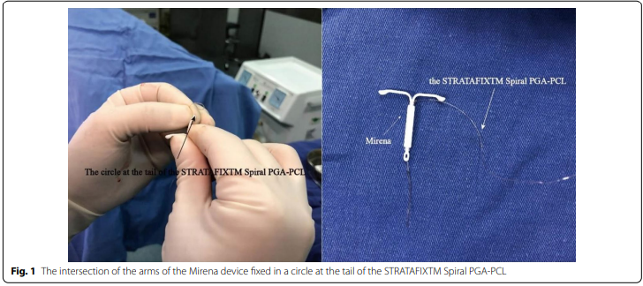

Slide 29
COMBINED ORAL CONTRACEPTIVES
Mechanisms of action: Decidualization and subsequent atrophy of the endometrium, anti-inflammatory effect by inhibiting the action of COX in adenomyotic spots
Effects: Benefit from the resulting amenorrhea
Side effects: Spotting, Headache, Thromboembolic events
Patients with dysmenorrhea and menorrhagia in fact may benefit from the resulting amenorrhea, which may provide relief of symptoms
COCs suppress aromatase expression in the eutopic endometrium and in adenomyotic foci

Slide 30
GnRH ANALOGUES
second-line treatment for adenomyosis when progestins are not efficacious or not tolerated by the patients.
Continuous GnRH-as initially causes a flare-up but subsequently suppresses FSH and LH secretion, leading to the blockade of sex steroid production.
GnRH-as can be used in the treatment of sex steroid-dependent diseases such as adenomyosis
Mechanisms of action:
Hypoestrogenic state (central downregulation and a deep suppression of gonadotropin Secretion).
Antiproliferative effect within the myometrium
Increased apoptosis in adenomyotic tissues
Reducing inflammation and angiogenesis

Slide 31
Effects:
Significant reduction of uterine size, bleeding and pain in short term period.
Improvement of pregnancy rate in ART cycles
Side effects: Menopausal symptoms (i.e., vasomotor syndrome, reduced bone mineral density, genital atrophy, mood instability) Consider add-back therapy for prolonged treatment.
To minimize side effects: Add-back therapy , even if a long-term treatment needed with GnRH analogues should be restricted to women unresponsive to other medications or in surgically high-risk patients.
Goserelin, leuprolide and nafarelin are commonly used in clinical practice.

Slide 32
Long-term, low-dose GnRH analogues, so-called draw-back therapy, tested in a small sample of women with adenomyosis.
Buserelin acetate per nasal administration for 2 years allowed maintenance of plasma estradiol levels within the therapeutic window, suppressing adverse events while maintaining therapeutic effects on adenomyosis.
The mean GnRHa dose during draw-back therapy was 435 microg/day (2.9 nasal sprays/day). The mean E2 level during draw-back therapy was 36.3+/-14.3 pg/ml.
Intensity of chronic pelvic pain was significantly lower during draw-back therapy than before draw-back therapy.
Severity of vasomotor symptoms during draw-back therapy was significantly lower
The decrease in BMD during a 6-month course of treatment was 0.96+/-0.9%.
Akira S, Mine K, Kuwabara Y, Takeshita T. Efficacy of long-term, low-dose gonadotropin-releasing hormone agonist therapy (draw-back therapy) for adenomyosis. Med Sci Monit 2009;1

Slide 33
GnRH Antagonists
Immediate suppression of reproductive function by inhibiting the secretion of FSH and LH
shown a dose-dependent rapidly reversible effect
GnRH-ant do not induce neither downregulation nor desensitization of receptors, as they act competitively preventing endogenous GnRH from binding and activating its pituitary receptor. Thus, depending on the dose of antagonist administered, the estradiol suppression can be modulated
The treatment may partially suppress estradiol without having to administer addback therapy, or fully suppress estradiol when combined with add-back therapy .
RCT: elagolix, an oral nonpeptide GnRH-ant: were effective in improving dysmenorrhea and non-menstrual pelvic pain during a 6-month period in women with moderate to severe endometriosis-associated pain.
Considering the promising results of GnRH-ant in endometriosis, a future use for treating adenomyosis-related symptoms may be hypothesized.

Slide 35
Eight women (aged 37–45 years) with adenomyosis confirmed by magnetic resonance imaging (MRI) were enrolled in a single-centre, open-label pilot study.
A once-daily regimen of 200 mg linzagolix for 12 weeks and then 100 mg for another 12 weeks decreased adenomyotic uterine volume and improved associated symptoms.
Donnez J, Donnez O, Brethous M, Bestel E, Garner E, Charpentier S, Humberstone A, Loumaye E. Treatment of symptomatic uterine adenomyosis with linzagolix, an oral gonadotrophin-releasing hormone antagonist: a pilot study. Reprod Biomed Online. 2022 Jan;44(1):200-203. doi: 10.1016/j.rbmo.2021.09.019. Epub 2021 Oct 3. PMID: 34799277.
Muneyyirci-Delale et al., demonstrated that elagolix, when used with add-back therapy, significantly reduces AUB in fibroids and coexisting adenomyosis
Relugolix: uterine volume significantly decreased in patients with adenomyosis coexisting with fibroids

Slide 36
The major advantages of these drugs over GnRH agonists are:
Water-soluble nature, allowing easy and tolerable oral administration
Rapid action without the initial 1–2 weeks of the flare-up effect
Dose-dependent and easily reversible modulation of the hypothalamic-pituitary-gonadal axis
Incomplete suppression of FSH and LH when administered at low doses, hence avoiding related side effects

Slide 37
major advantage of GnRH antagonist in the context of infertility management
Borini and Cticchio : potential superiority of GnRH antagonist over GnRH agonist in patients wishing to preserve their fertility, because does not radically suppress circulating LH, and its impact on the hypothalamic-pituitary-gonadal axis can be easily reversed .
Borini, A.; Coticchio, G. Gonadotropin-releasing hormone antagonist linzagolix: Possible treatment for assisted reproduction patients presenting with adenomyosis and endometriosis Fertil. Steril. 2020, 114, 517–518

Slide 38
Danazol
Derivative of 12 ethinyl testosterone, strong antigonadotropic properties
The androgenic and hypoestrogenic milieu
Studies : danazol has a direct effect on cell proliferation, inhibiting DNA synthesis, inducing apoptosis .Reduction in estrogen receptor in glands and stromal cells , induces atrophy in lesions.
The study by Ota et al., the only RCT on danazol, compared hysterectomy versus a 4 month treatment with 400 mg of daily danazol
Posttreatment autoantibody levels and antiphospholipid levels were decreased, due to the inhibitory effect of danazol on the autoimmunological response associated with adenomyosis.
Danazol has an inhibitory effect on the autoimmunologic response associated with adenomyosis

Slide 39
Side effects :
Limited evidence is available on systemic treatment of adenomyosis with danazol, due to the high incidence of androgenic side effects.
weight gain, acne, oily skin or hair, flushing, hair loss, voice changes (hoarseness, ), sore throat, abnormal growth of body hair (in women), vaginal dryness, decreased breast size, water retentions, menstrual changes (spotting, missed periods), mood changes.
Igarashi use danazol to treat adenomyosis, an intrauterine device containing 175 mg of danazol. resulted in effective reduction the size of the uterus and pregnancy was achieved in 66.6% cases.

Slide 40
Cervical injections of danazol at 2 week intervals for 12 weeks ,successfully used, with 60% improvement in bleeding, pain, and dyspareunia, and a decrease in uterine size., blood danazol levels were undetectable, ovulation was not inhibited, and no side effects reported .
A prospective study : long-term vaginal administration of one 200 mg danazol tablet effective in reducing bleeding and pain in adenomyotic women.
Long-term treatment, with a reduction of uterine volume evaluated by ultrasound. The 6-month treatment followed by a cyclic 3-month treatment for a further 18 months had the best compliance in symptomatic patients with adenomyosis.

Slide 41
Aromatase Inhibitors
aromatase P450: synthesis of estrogen from androgens
the endometrium of women with endometriosis, adenomyosis and leiomyomas: abnormal expression of aromatase P450 lead to increased estrogen production and expression of prostaglandin E2.
anastrozole or letrozole
The first documented use of (AIs): severe adenomyosis refractory to GnRH analogues and danazol, wished to preserve her fertility.
Anastrozole orally for 16 weeks, with GnRH analogues, to suppress the ovarian production of estrogens. Reduction of uterine volume was 60% after 8 weeks of treatment , the patient had no AUB for 6 months after cessation .
RCT comparing 3 months aromatase inhibitor (letrozole 2.5 mg/d) and goserelin 3.6 mg monthly AIs have the same efficacy as GnRH analogues in reducing adenomyoma volume both treatments a significant difference in uterine volume after 3 months, The GnRH-a was more effective than letrozole in relieving chronic pelvic pain, dysmenorrhea, menorrhagia, metrorrhagia, and dyspareunia, but this difference was not significant.
. AIs seems to have a promising future for adenomyosis in cases of resistance to other treatments even though additional studies are needed.

Slide 43
(RCT) by Badawi et al., GnRH agonists(goserelin) and aromatase inhibitors(Letrozole) shown to be equally effective in reducing adenomyosis and improving clinical symptoms .
Results : comparable decrease in uterine volumes (13 cm3 in letrozole group vs. 11.7 cm3 in goserelin group, at 12 weeks), and adenomyoma volumes
aromatase inhibitors are as effective as GnRH agonists in reducing progression and improving symptoms of adenomyosis.

Slide 44
Dopamine Receptor Agonists
Prolactin and its receptors seem to increase in adenomyotic tissue, prolactin effects in the promotion of gland/cell proliferation and function.
animal models have shown increased uterine concentration of prolactin (PRL) as a risk factor
PRL is synthesized also in the myometrium and directly promotes uterine smooth muscle cell growth and proliferation. acts as a smooth muscle cell mitogen
Another potential reason for the improvement of adenomyosis is the inhibition of angiogenesis, Dopamine agonists, prevent VEGF receptor-2 binding and reduce angiogenesis.

Slide 45
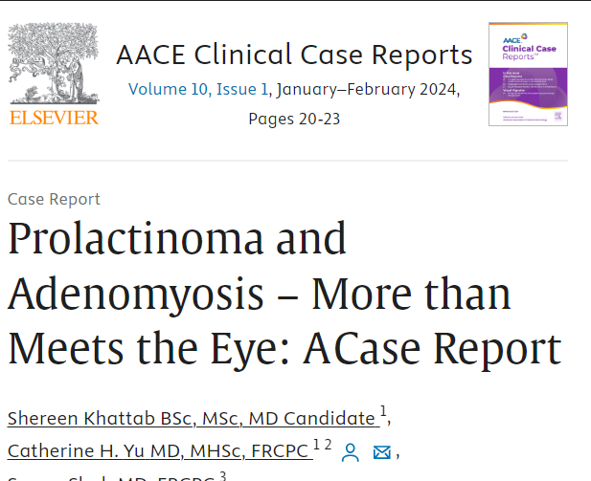

Slide 46
A 35-year-old, HX: Graves’ disease ,& pituitary microadenoma ,previously treated with cabergoline which was stopped after 12 months. Then A pelvic ultrasound :adenomyosis. . started on cabergoline 0.25 mg weekly in October 2021. Within 2 months of initiation of cabergoline, resolution of symptoms and radiological resolution of adenomyosis.
A pilot study by Andersson et al. evaluated treatment with vaginal bromocriptine for 9 months in 19 patients with adenomyosis .reported significant improvements in AUB, dysmenorrhea, and quality of life following.
In another study Andersson et al. evaluated bromocriptine using imaging(MR, vaginal ultrasound), Vaginal bromocriptine may have an impact on adenomyosis that is reflected in radiological appearance.
.

Slide 48
18, aged 35–50, with heavy menstrual bleeding and diffuse adenomyosis according to both MRI and TVU were included.
The subjects underwent treatment with vaginal bromocriptine for 6 months. MRI and TVU were performed at baseline and after 6 months of medication.
TVU showed a significant decrease in JZ max (8.5 vs. 7.9 mm, p = 0.02) and a reduced number of women with asymmetric myometrial wall thickness.
Significant improvement in menstrual bleeding, pain and quality of life after vaginal bromocriptine treatment suggests a novel therapeutic agent for adenomyosis
small pilot study

Slide 49
Selective Progesterone Receptor Modulators
Progesterone agonist and antagonist activities in the endometrium
reducing pain, bleeding, cell proliferation , inflammation.
Previous evidences on mifepristone showed increase the caspase 3 expression in adenomyosis tissue, inducing cell apoptosis, inhibiting the onset and development of adenomyosis .
anti-inflammatory :reducing IL-6 and TNF-α from endometrial cells
alternative therapeutic for hormon edependent diseases (uterine leiomyomas and endometriosis) -other treatments are not feasible or have failed
A few small clinical studies on endometriosis : the potential application of SPRMs in adenomyosis.
Mifepristone 50-mg daily improved pain and regression of endometriotic lesions . Similarly, asoprisnil and telapristone acetate have also been reported to relieve endometriosis-associated pain .
Require investigations and well designed, RCT to assess their long-term effects in adenomyosis.

Slide 51
Evaluate the effect of a 10 mg per day 12 week treatment of ulipristal acetate (UPA) on abnormal uterine bleeding due to adenomyosis.
A significant decrease in pain and menstrual volume in 13 weeks in the UPA group (p < 0.01). No serious adverse event was recorded.
Conclusion: UPA could be an interesting option for treatment of abnormal uterine bleeding related to adenomyosis in women wishing to preserve their fertility.

Slide 52
Valproic Acid
Class I histone deacetylases expression found to be increased in eutopic and ectopic endometrium in adenomyosis, correlating with severity of dysmenorrhea.
Histone deacetylases play an important role in steroid hormone–dependent gene expression and in modulating cell survival and proliferation .
Valproic acid (VPA), a specific and potent histone deacetylase inhibitor effective in treating a small series of women with adenomyosis, decreasing dysmenorrhea and uterine bleeding, and reducing the uterus size .
12 patients ,adenomyosis ,dysmenorrehea , enlarged uterus. All patients took VPA for 3 months, VPA treatment resulted in complete resolution of dysmenorrhea and an average reduction in uterine size by 26% 6 months after the treatment.
Liu X, Yuan L, Guo S-W. Valproic Acid as a Therapy for Adenomyosis: A Comparative Case Series. Reproductive Sciences. 2010;17(10):904-912. doi:10.1177/1933719110373807

Slide 53
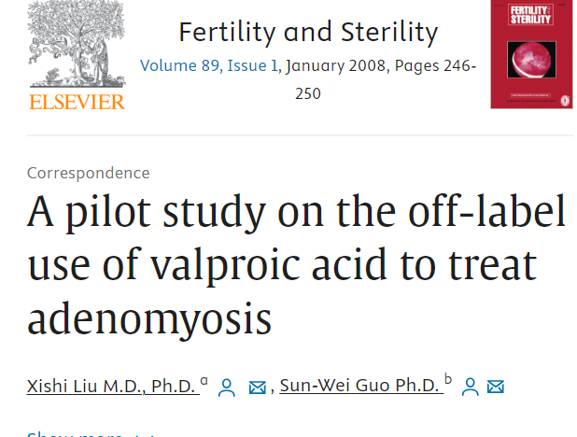

Slide 54
a pilot study on the off-label use of valproic acid to treat adenomyosis. by the end of the 3-month treatment, all three recruited patients reported complete disappearance of dysmenorrhea, with an average of one-third reduction in uterus size.
Liu X, Guo SW. A pilot study on the off-label use of valproic acid to treat adenomyosis. Fertil Steril. 2008 Jan;89(1):246-50. doi: 10.1016/j.fertnstert.2006.11.009. Epub 2007 Jan 18. PMID: 17239872.
Studies on murine models of adenomyosis showed the mechanism of action of VPA, that suppressed myometrial infiltration, improved generalized hyperalgesia, and reduced the amplitude and irregularity of uterine contractions .
Liu X, Guo SW. Valproic acid alleviates generalized hyperalgesia in mice with induced adenomyosis. J Obstet Gynaecol Res. 2011 Jul;37(7):696-708. doi: 10.1111/j.1447-0756.2011.01655.x. Epub 2011 Jun 9. PMID: 21651672.
Despite these promising results in favor of the use of histone deacetylase inhibitors, so far no clinical trials have been conducted to evaluate the efficacy of VPA in adenomyosis

Slide 55
Anti-platelet Therapy
theory adenomyotic lesions are wounds undergoing repeated tissue injury and repair. Platelets induce fibroblast-to-myofibroblast transdifferentiation, leading ultimately to fibrosis .
A recent study in a mouse model of adenomyosis: anti-platelet treatment (thromboxane A2 synthesis inhibitor) is efficacious in suppressing myometrial infiltration, improving generalized hyperalgesia, reducing uterine hyperactivity decreased expression of some proteins involved in adenomyosis fibrogenesis, supporting the promising role of anti-platelets therapy in adenomyosis .
Zhu B, Chen Y, Shen X, Liu X, Guo SW. Anti-platelet therapy holds promises in treating adenomyosis: experimental evidence. Reprod Biol Endocrinol. 2016 Oct 10;14(1):66. doi: 10.1186/s12958-016-0198-1. PMID: 27724926; PMCID: PMC5057470.
However, so far there are currently no studies published or registered on the use of agents targeting platelets on human

Slide 56
Oxytocin Antagonists
Being investigated because overexpression of oxytocin receptor has been demonstrated in uteri with adenomyosis
In a phase I trial, Epelsiban, a selective oxytocin receptor antagonist, tested and found to be well tolerated with no significant safety concerns .
Further trials needed to evaluate the efficacy.
Studies increased expression of OTR in the positively correlates with the amplitude of uterine contractions , lead to pathological and uncoordinated myometrial spasms, severe dysmenorrhea and reduced fertility .
Compared with normal endometrium, the immunoreactivity of OTR is significantly increased in the ectopic endometrium.

Slide 58
The total density of OTR(Oxytocin Receptor) in the adenomyotic lesion foci was 73.7 and 35.2 in control group (p <0.05), indicates a significant effect of oxytocin as a ureterotonic peptide.
Conclusion: Pelvic pain pathogenesis in women with diffuse adenomyosis compared with the painless form of the disease is an increase in the activity of ureterotonic factors of OTR.
Compared to the painless form of adenomyosis, the myometrial innervation of patients with pelvic pain is characterized by a significantly higher expression of nerve growth factor.
Mekan Orazov, Victor Radzinsky, Olga Sharapova, Igor Kostin & Yurii Chitanava (2020) Oxytocinergic regulation in pathogenesis of pelvic pain caused by adenomyosis , Gynecological Endocrinology, 36:sup1, 20-23

Slide 59
MEDICAL TREATMENT IN INFERTILE WOMEN WITH ADENOMYOSIS
Prevalence of adenomyosis is higher in patients with fertility problems, ranging from 20%–25% in women undergoing ART .
Adenomyosis has a detrimental effect on IVF clinical outcomes, reducing pregnancy and live birth rates and increases the miscarriage rate.
uterus and its anatomical distortion : intramural adenomyoma can affect uterogamete and/or the embryo transport or the receptivity of the endometrium
However, there is no agreement on the most appropriate therapeutic methods for managing
A number of studies have shown that GnRH treatment may improve the reproductive performance, possibly promoting uterine and endometrial receptivity.

Slide 60
The first case reports on the use of GnRH analogues:
showed that after a 6-month treatment with nafarelin acetate or a 5-month treatment with leuprolide acetate respectively, two women with severe adenomyosis spontaneously conceived.
The use of GnRH analogues tested before and after surgical treatment for adenomyosis, with relatively good results for fertility.
Studies shown GnRH analogues before (IVF) cycles significantly increases the chances of pregnancy in infertile women with adenomyosis or endometriosis

Slide 61
Niu et al.: long-term GnRH agonist pretreatment improves pregnancy outcomes in adenomyosis patients undergoing frozen embryo transfer (FET) after preparation of the endometrium with hormone replacement therapy . Gynecol Endocrinol 2013;29:1026–30.
Another study conducted on 241 infertile women with adenomyosis and fresh embryo transfer (ET) cycles or FET cycles: Park CW, Choi MH, Yang KM, Song IO. Pregnancy rate in women with adenomyosis undergoing fresh or frozen embryo transfer cycles following gonadotropin-releasing hormone agonist treatment. Clin Exp Reprod Med 2016;43:169–73.
Fresh ET cycles : no difference between cases with or without GnRH analogues pretreatment with goserelin for 2-3 months, indicating GnRH analogues pretreatment has no benefit in improving IVF outcomes in these cases.
FET cycles: a higher clinical pregnancy rate observed in women after GnRH pretreatment (39.5%) than those undergoing to fresh ET with (30.5%) or without (25.2%) GnRH analogues pretreatment

Slide 62
Adenomyosis has a detrimental effect on IVF clinical outcomes, reducing pregnancy and live birth rates and increases the miscarriage rate.
Pre-IVF treatment with the use of GnRH analogues down-regulation may be beneficial, but further studies are needed

